Slide 1
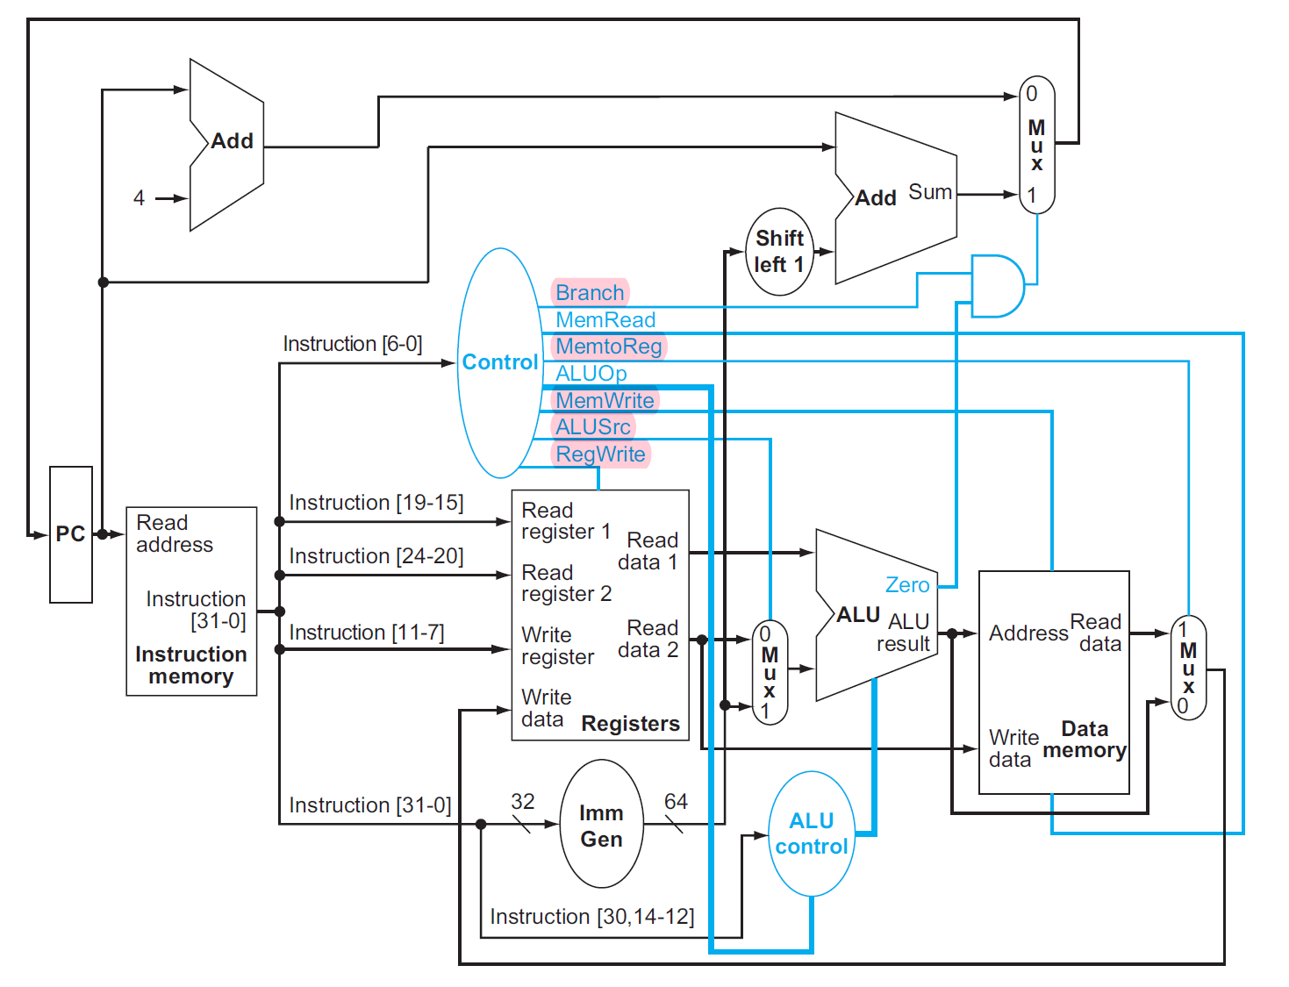
ADD
0
1
2
ADD
MUX
4
format_type
C
T
R
L
(MSB)
[31:0]
D_MEM_WEN
PCSrc (LSB)
D_MEM_BE
ALUCode
WhatToReg
PC
RF_WE
ALUSrc
[19:15]
D
RF
ADDR D
INST[31:0]
I_MEM
RA1
[24:20]
RD1
ALU
RA2
cmp
D
D_MEM
[11:7]
WA
RD2
0
1
2
result
ADDR
DO
0
1
2
3
4
WD
MUX
DI
MUX
[31:7]
IMM_GEN

Slide 3
RG_ALU1
ADD1
0
1
2
3
ADD2
MUX2
4
format_type
RG_ALU2_?
C
T
R
L
(MSB)
PCSrc (LSB)
[31:0]
D_MEM_WEN
JUMP
EXE
AUIPC
D_MEM_BE
WhatToOut
ALUCode
WhatToReg
[6]
PC
[19:15]
ALUSrc
RF_WE
D
RF
ADDR D
INST[31:0]
I_MEM
RA1
[24:20]
RD1
ALU
LS_FILL
RA2
RG_ALU0_?
cmp
D
D_MEM
IF
[11:7]
WA
RD2
0
1
2
result
ADDR
DO
0
1
2
3
4
RG_ID
MUX1
WD
RG_MEM_??
ID
MUX3
DI
[31:0]
IMM_GEN
MEM
0
1
2
WB
RG_WB
MUX4
OUTPUT
_PORT

Slide 4
B type
IF
ID
EXE
All
All
All excl. Store
and Branch
J type, R type,
I type excl. load
Load/S type
WB
MEM
Load
S type

